Slide 1
Silicon oxidation

Slide 2
Silicon oxidation
Formation of silicon dioxide (SiO₂) on silicon surface, in an oxidant ambient (O₂, H₂O).
SiO₂ can also be deposited on silicon ( see other lessons)
Si + O₂ → SiO₂ [dry oxidation]
or
Si + H₂O →SiO₂+2H₂ [wet oxidation]

Slide 3
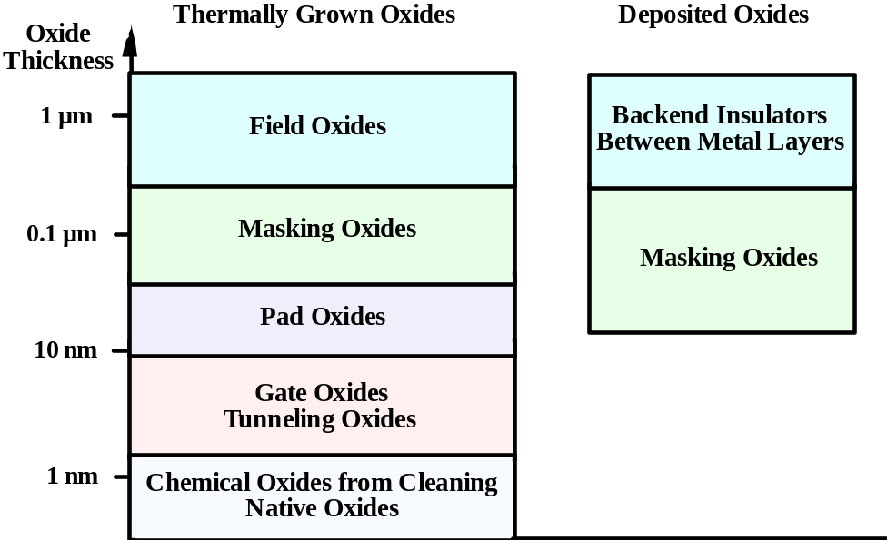
Why SiO₂
Si is widely used in IC because it forms an excellent oxide, with a nearly defect-free interface.
Note: Silicon will oxidize in air at room T but...
Not enough energy for O₂ to diffuse through SiO₂ after a firs thin oxide layer is formed
Native oxide won’t grow more than 2 nm
Typical oxidation temperatures:
From 700 to 1100 °C

Slide 4
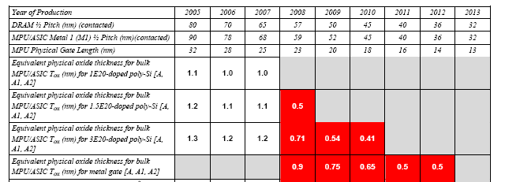
ITRS roadmap for gate dielectrics

Slide 5
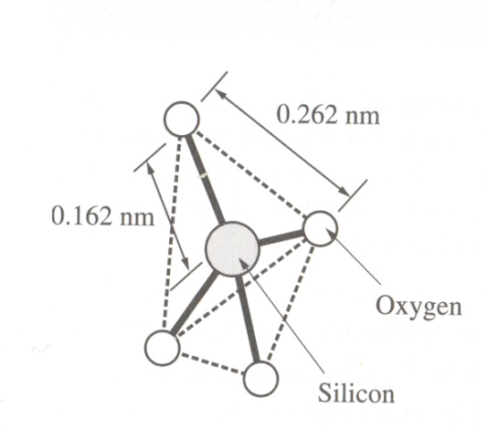

SiO₂ structure
SiO₂ is grown as fused silica → amorphous with low range order
Rate of crystallization at typical process T can be neglected
Basic unit: SiO₄ tetrahedra
Some O atoms are bonded to two Si atoms → bridging oxygen
O atoms bonded to a single Si atom → non bridging oxygen
Higher fraction of bridging to non bridging oxygen → higher cohesion and structural strength of SiO₂ (dry ox. Have more bridging O₂ than wet ox.)

Slide 6
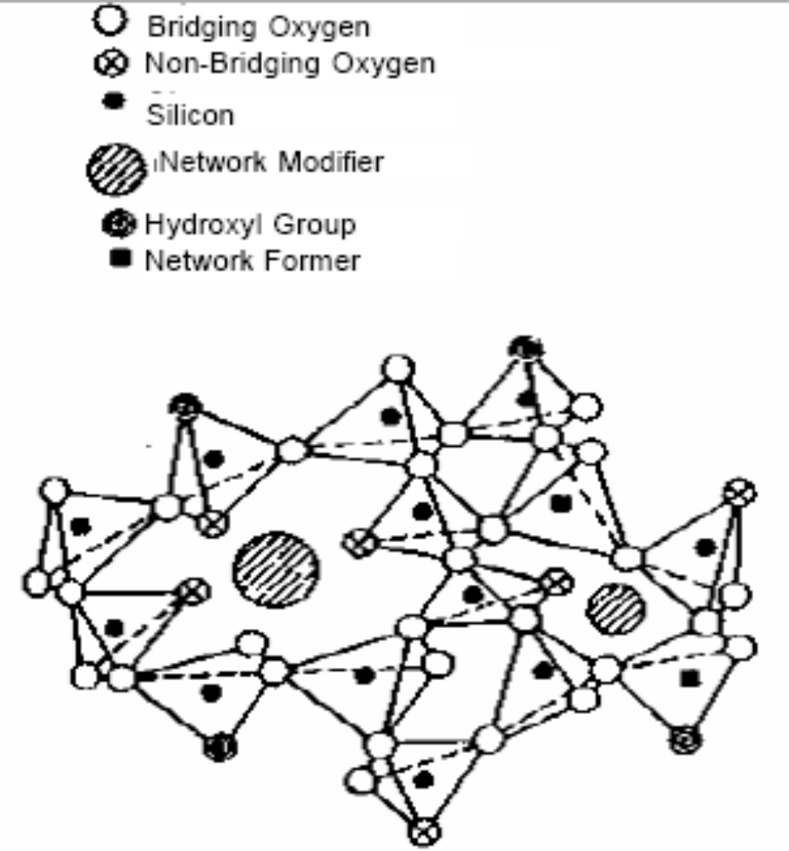
SiO₂ structure: impurities
Substitutional impurities:
Replace silicon in the structure (network formers) which brings to the elimination (structure weakening) or formation of bridging oxygen (ex. Boron - Phosphorus)
Interstitial impurities:
Interstitial impurities (ex. Na, K) increase the amount of non bridging oxygen making the structure weaken and porous and increasing the diffusivity of other species within the glass (network modifiers)
Water in SiO2
Si:O:Si → Si:O:H+H:O:Si
Hydroxyls are generated and substitute bridging oxygen. The H bond is quite weak and can be easily removed → charged states or traps can be generated

Slide 7
Oxidation kinetics
The oxidation process occurs at the Si/SiO₂ interface
O₂,H₂O
Demonstrated by several experiments, e.g. Oxygen isotopes profiling
Diffusion
SiO₂
Reaction
Si + O₂ → SiO₂
Si + H₂O →SiO₂+2H₂
Silicon
Oxygen or water must diffuse through the silicon oxide to react at silicon surface

Slide 8
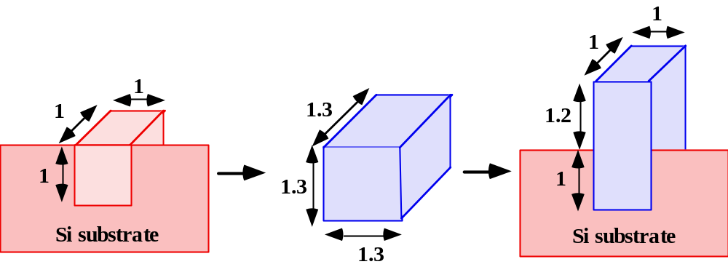
Oxidation kinetics
Oxidation involves a volume expansion:
  ~46% of oxide thickness grows INTO the silicon, that is the silicon surface is “pushed” away for a 46% of the oxide thickness.
Stress can play a determinant role in oxidation kinetics

Slide 9
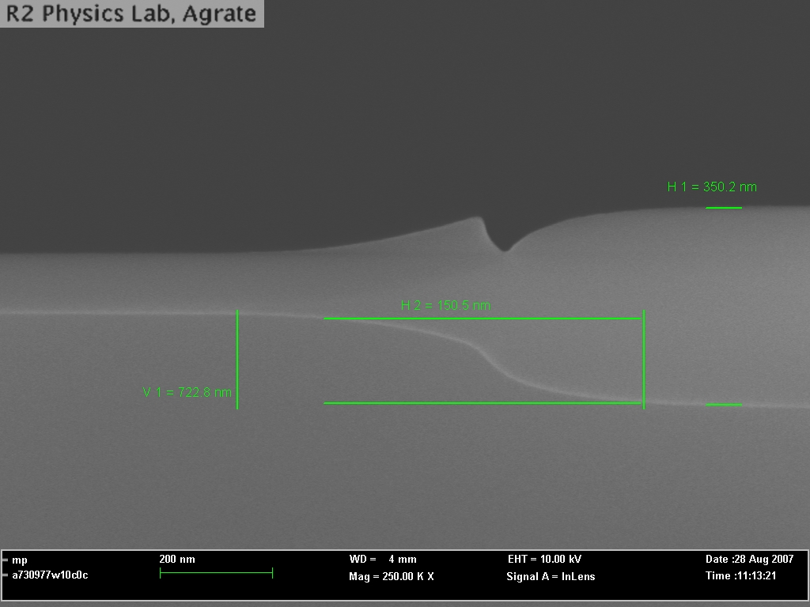
LOCOS oxidation

Slide 10
The Deal-Grove model of oxidation
Gas (stagnant layer)
Definitions:
C_{g}= Oxygen concentration at the end of stagnant layer
C_{s}= Oxygen concentration at the SiO₂ surface
C₀= Oxygen concentration in the oxide at the oxide surface
C_{i}= Oxygen concentration at the oxide/silicon interface
F₁= Oxygen flux in the stagnant layer
F₂=Oxygen flux in the oxide
F₃=Oxygen flux in Si
x
C_{g}
C_{s}
C_{o}
C_{i}
F₁
F₂
F₃
SiO₂
Si

Slide 11

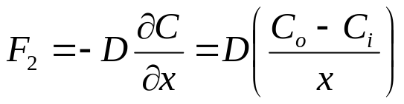

The Deal-Grove model of oxidation
Gas (stagnant layer)
x
Mass transport in gas phase
C_{g}
C_{s}
C_{o}
C_{i}
Solid state diffusion (Fick’s law)
F₁
F₂
F₃
SiO₂
Si
Chemical reaction

Slide 12
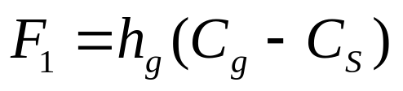

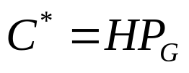
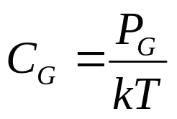
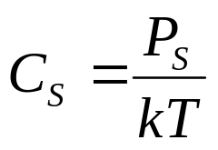
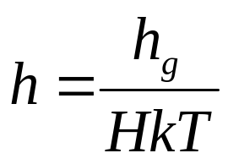
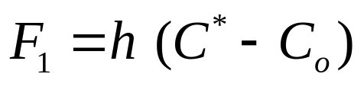
The Deal-Grove model of oxidation
F1 calculation
Gas (stagnant layer)
Mass transport coefficient
x
C_{g}
C_{s}
C_{o}
C_{i}
From Henry’s law:
F₁
Partial pressure at oxide surface, not known experimental parameter
F₂
F₃
SiO₂
Si
We introduce;
From perfect gas law

Slide 13
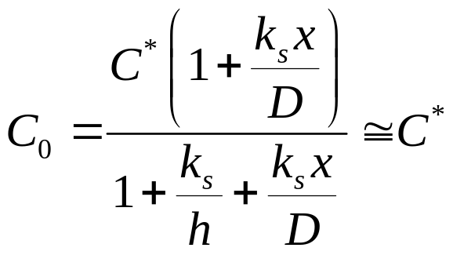
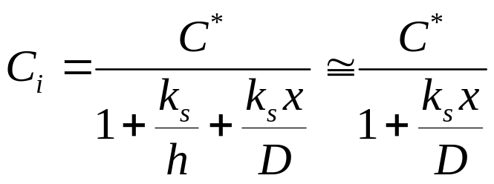
The Deal-Grove model of oxidation
C_{i} calculation
Gas (stagnant layer)
x
Assuming no O₂ is generated into the oxide.
C_{g}
C_{s}
C_{o}
C_{i}
F₁
F₂
And that the reaction rate is proportional to the oxidant concentration
F₃
SiO₂
Si
Interface reaction rate constant
In steady state conditions F₁=F₂=F₃; after some algebra
Notes:
Le approssimazioni per C1 e CO sono valide per h grande, il che in genere e’ vero…

Slide 14
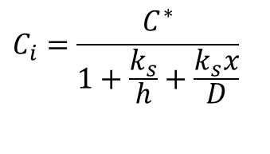
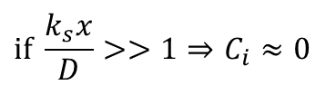
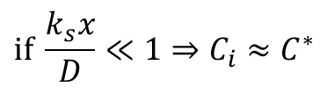
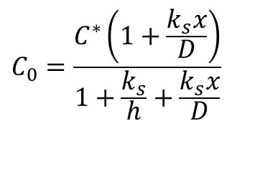
The Deal-Grove model of oxidation
C_{i} calculation
$$C_{0}=\frac{C^{∗}\left(1+\frac{k_{s}x}{D}\right)}{1+\frac{k_{s}}{h}+\frac{k_{s}x}{D}}$$
$$C_{i}=\frac{C^{∗}}{1+\frac{k_{s}}{h}+\frac{k_{s}x}{D}}$$
$$\text{if} \frac{k_{s}x}{D}≪1⇒C_{i}≈C^{∗}$$
Reaction controlled regime
$$\text{if} \frac{k_{s}x}{D}>>1⇒C_{i}≈0$$
Diffusion controlled regime

Slide 15
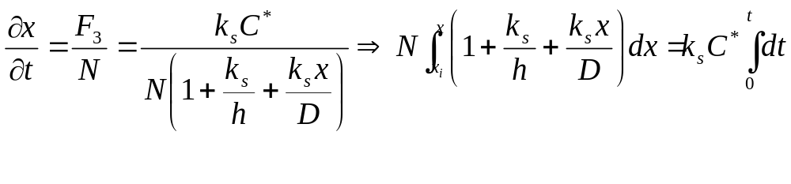
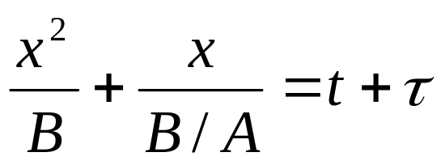
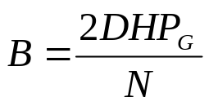
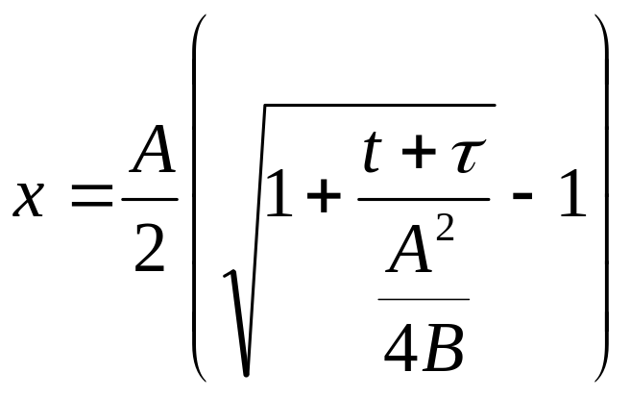
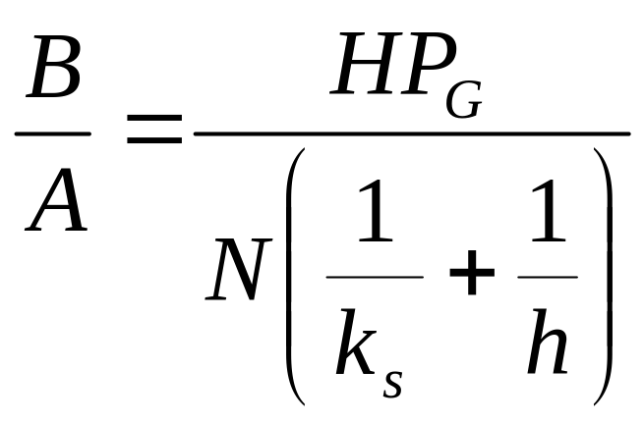
The Deal-Grove model of oxidation
Growth rate calculation
Gas (stagnant layer)
The growth rate is nothing but the flux F₃ divided by the number of oxidant molecules incorporated per unit volume of oxide grown N
x
C_{g}
C_{s}
C_{o}
C_{i}
F₁
F₂
F₃
SiO₂
Si
Parabolic rate constant
Linear rate constant

Slide 16
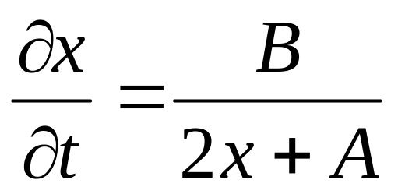


The Deal-Grove model: fundamental equations

Slide 17
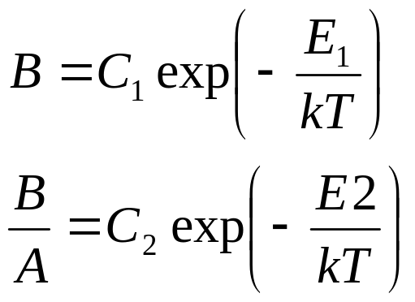
The Deal-Grove model
A and B/A
B and B/A are of course function of temperature. T dependence can be described as:
Ambient | B | B/A
Dry | C₁=7.72E2 μm²hr⁻¹ E₁=1.23eV | C₂=6.23E6 μm²hr⁻¹ E₁=2.0eV
Wet | C₁=3.86E2 μm²hr⁻¹ E₁=0.78eV | C₂=1.63E8 μm²hr⁻¹ E₂=2.05eV
Valid for (111) orientation, for (100) C₂ must be divided by 1.68
B is more strictly related to diffusion → activation energies are very different between dry and wet ox.
B/A is more related to reaction at Si surface → activation energies are close to th energy needed to break Si-Si bonds.

Slide 18
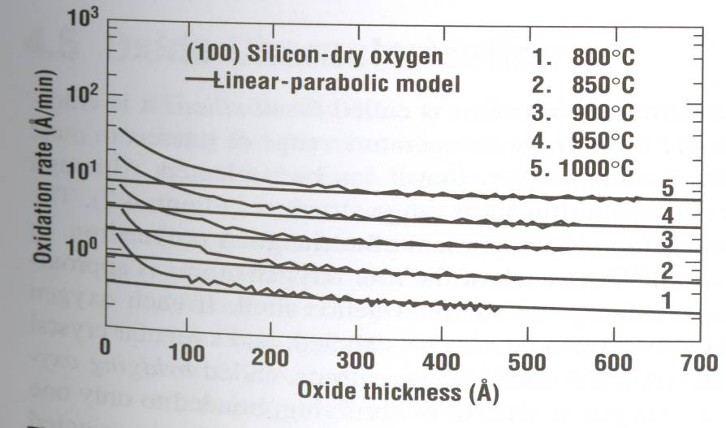
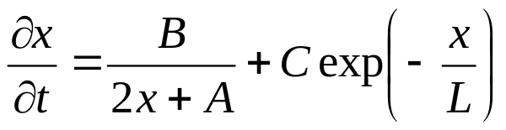
Corrections to Deal-Grove model
The Deal-Grove model does not work for thin oxides !
No clear explanation of thin film regime yet:
O₂⁻ coupled diffusion
Thermoionic emission of electrons from Si into SiO₂
Micro-pores
Blocking layers
Additional Si layers participating to oxidation
Massoud et al.:
Deal-Grove term

Slide 19
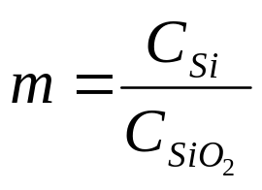
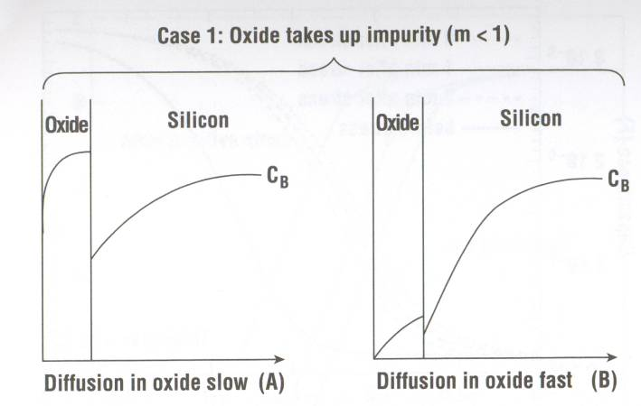
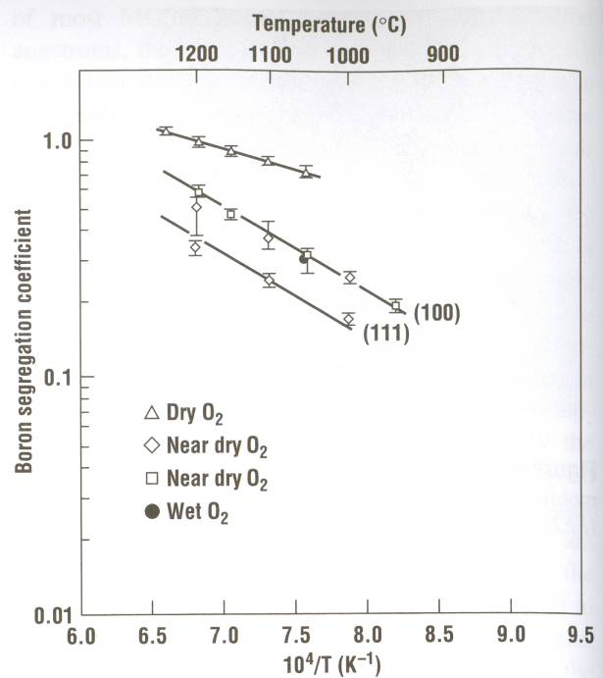
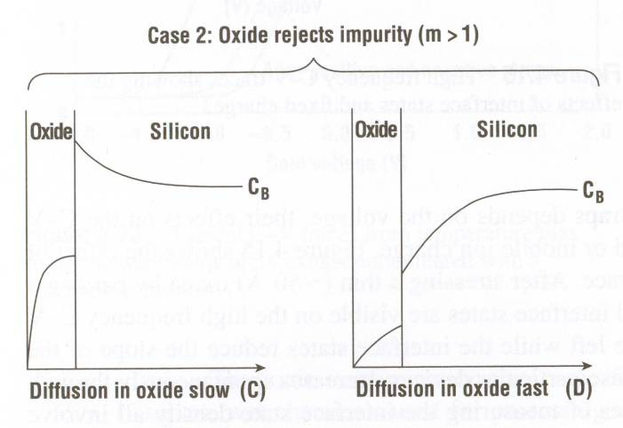
Oxidation rate and substrate doping
The substrate doping profile will change during oxidation, depending on impurities diffusivity and segregation coefficient (m).
m<1 for Boron
m~10 for P,As,Sb

Slide 20
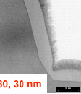
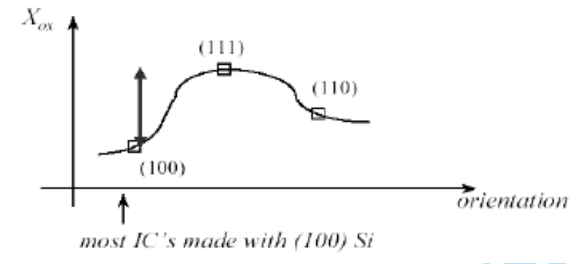
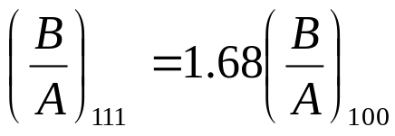
Oxidation rate and crystal orientation
B does not depend on crystal orientation
B/A strongly depends on it
Why?
  Number of Si bonds available for cm⁻²
  Orientation dependent stress in some cases (?)
Inverted trend for thin oxides at low O₂ pressure and high pressure H₂O grown oxides

Slide 21
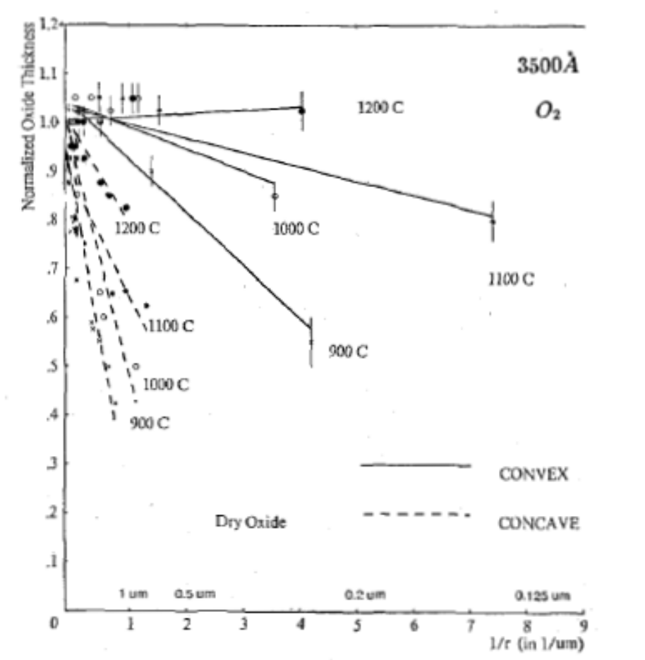
2D oxidation
Parameters to be kept into account when studying 2D oxidation:
  Effects of crystal orientation on oxidation rate
  Dependence of oxidant diffusion on local shape
  Viscous flow
  Stress effects
In a classical paper (see references) Kao et al. studied oxidation rates as a function of radius of curvature of different structures

Slide 22
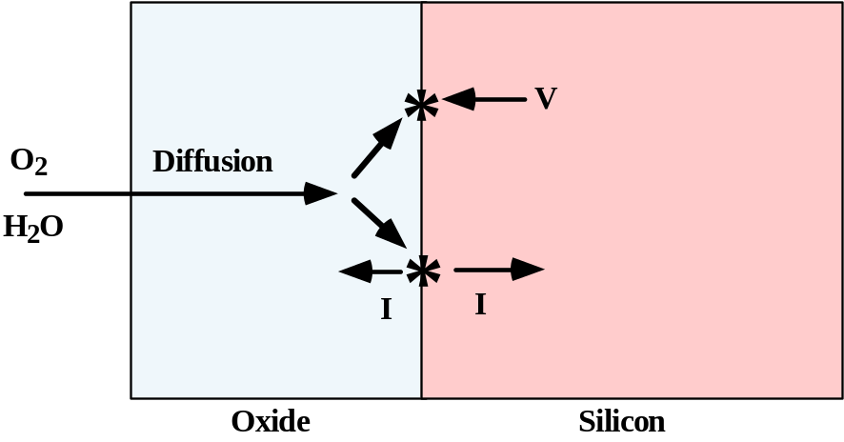
Microscopic model for oxidation
Oxidation processes “consume” vacancies and produce interstitial.
  Part of the volume expansion can be modeled by vacancies consumption.
  Interstitial injection can explain dopant diffusion phenomena (OED, ORD) and extended defects formation (Oxidation-induced Stacking Faults, OSF)
Notes:
e’ il numero di interstiziali per atomo di ossigeno che prendono parte alla reazione, β e’ lo stesso numero per le vacanze.

Slide 23
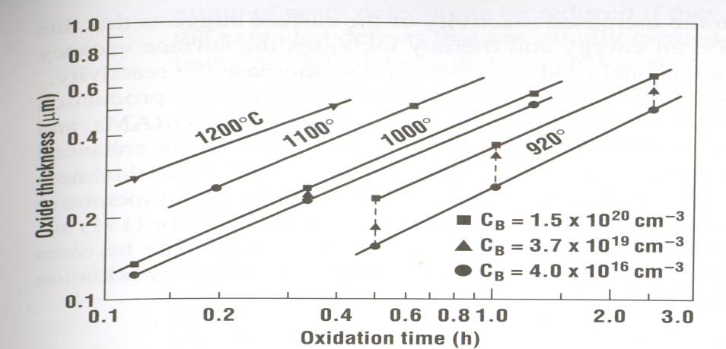
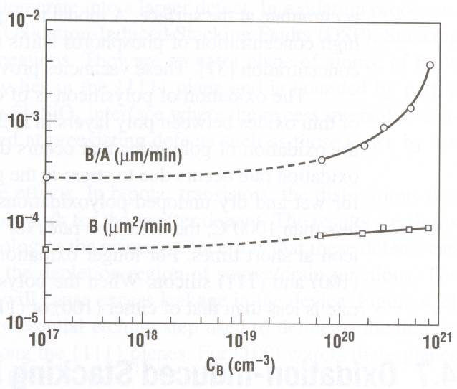
Oxidation rate and substrate doping
All kinds of substrate doping increase oxidation rate
B is incorporated into SiO₂ and weakens the oxide structure
Oxidant diffusion is thus enhanced
P doping shows a huge increase of B/A
Probably E_{f} shift increases vacancy concentration → more oxidation sites available.

Slide 24
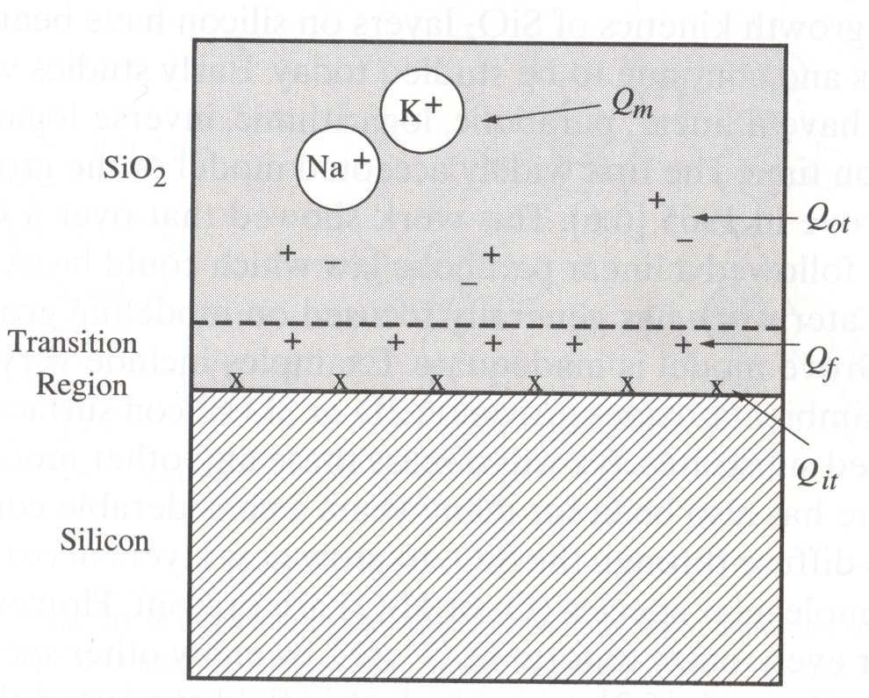
Charge in SiO₂
Si/SiO₂ defects: 10⁹-10¹¹ cm⁻²
Si surface atoms ∼10¹⁵ cm⁻²
4 main kinds of defects:
Q_{f}= fixed oxide charge
  A sheet of positive charge close to the interface (∼2nm).
  Believed to be formed of incompletely oxidized Si atoms
  Does not change during device operation.
  Can be reduced by high T anneal after oxidation.

Slide 25
Charge in SiO₂
Si/SiO₂ defects: 10⁹-10¹¹ cm⁻²
Si surface atoms ∼10¹⁵ cm⁻²
4 main kinds of defects:
Q_{it}= interface trapped charge
  Located at the interface
  Probably related to incompletely oxidized Si end/or dangling bonds
  Can be positive/negative or neutral
  Traps levels in the forbidden gap (usually near valence and conduction band).
  450°C H₂ anneal is effective in reducing Q_{it} denisty

Slide 26
Charge in SiO₂
Si/SiO₂ defects: 10⁹-10¹¹ cm⁻²
Si surface atoms ∼10¹⁵ cm⁻²
4 main kinds of defects:
Q_{M}= mobile ionic charges
  Attributed to alkali ions (Na, K, Li) as well as negative ions and heavy metals
  Less important if contamination is kept under control in clean room
  Cleaning furnace tubes with HCl helps preventing contamination.

Slide 27
Charge in SiO₂
Si/SiO₂ defects: 10⁹-10¹¹ cm⁻²
Si surface atoms ∼10¹⁵ cm⁻²
4 main kinds of defects:
Q_{ot}= oxide trapped charge
  Located anywhere in the oxide
  Broken Si-O bonds
  Result in traps in the bulk oxide
  Usually due to ionizing radiation or damaging process steps (ion implantation, plasma etching…)

Slide 28
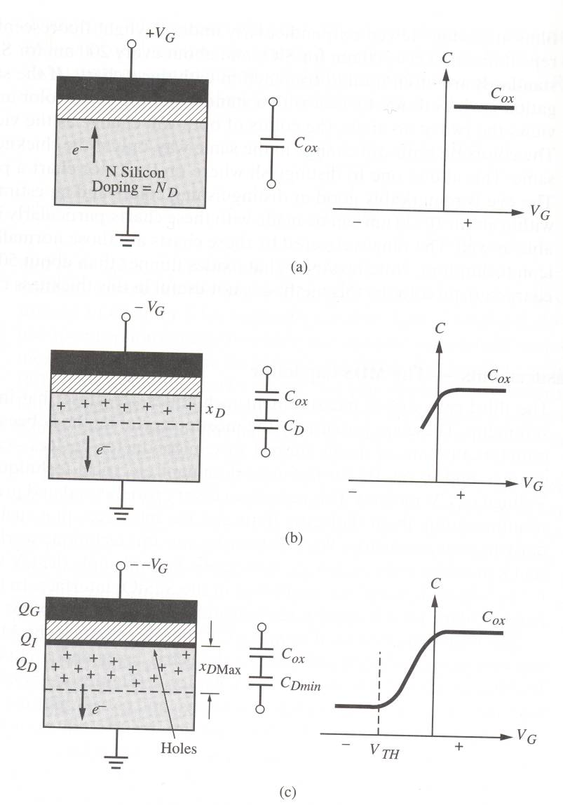
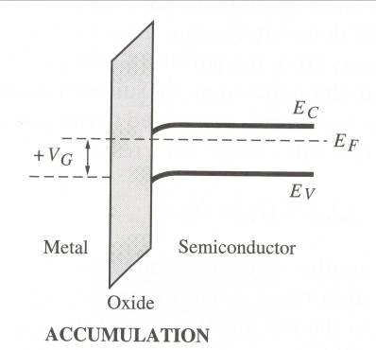
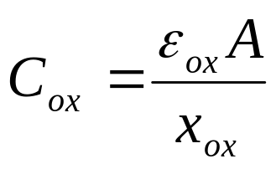
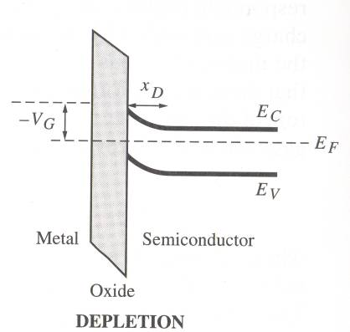
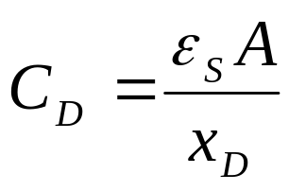
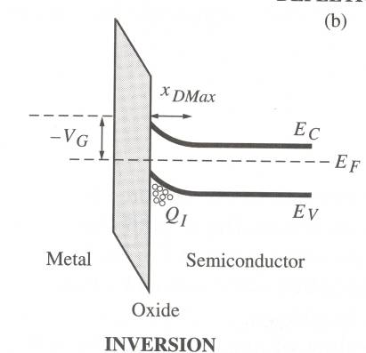
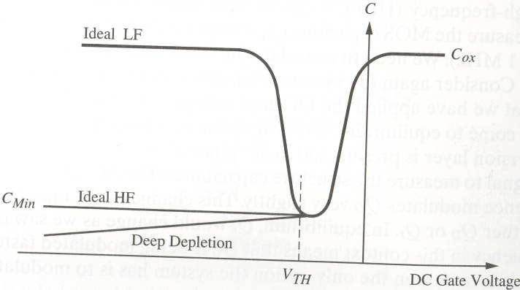
CV characterization of SiO₂

Slide 29
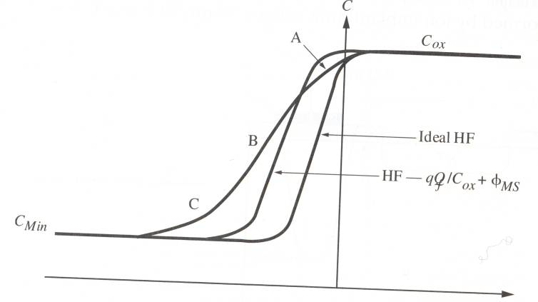
CV characterization of SiO₂
Q_{f} presence:
Inversion is more difficult to obtain since a negative image charge is formed in the silicon.
C/V characteristic is shifted to the left
Q_{m} shows a similar effect ( but of different amplitude since the position of the charge in the oxide is not fixed)
Q_{it} presence:
E_{f} moves with respect to valence and conduction band sweeping the CV curve → interface traps are filled and emptied → CV curve is “stretched”
A zone: int. states near conduction band
B zone: int. states near mid band gap
C zone: inte. States near valence band

Slide 30
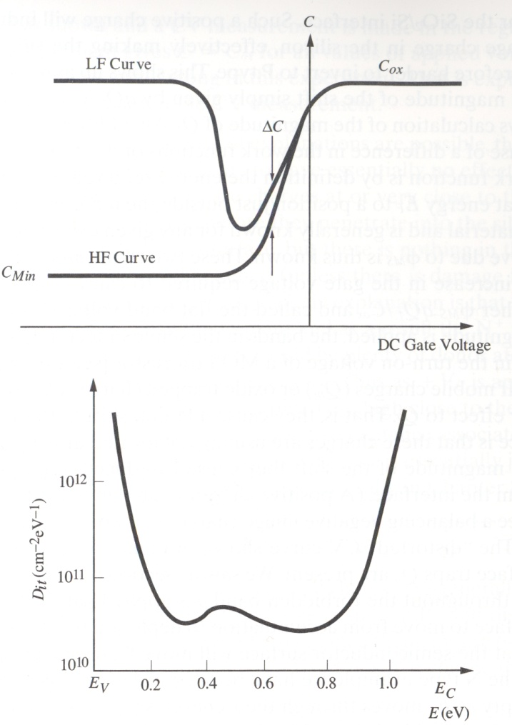
CV characterization of SiO₂
Interface state density
Quasi-static method:
Distortion of LF curve with respect to HF curve is due to interface states
Other commonly measured paramaters:
  Breakdown voltage
  Charge to breakdown by TDDB (Time dependent dielectric breakdown) test
  Mobile charge estimation by BTS ( Bias Temperature Stress)

Slide 31
Nitridation
Nitridation is mainly utilized to form a barrier to the diffusion of B from the control gate into the silicon substrate and to improve thin oxide electrical quality (Qbd, resistance to trapping and to the generation of interface states after hot electron stress)
Most common nitridation techniques consist in annealing treatments made after the thermal oxidation step, at high or medium temperature with NH3 , N2O, NO by furnace or RTP.
Nitridation by NO is becoming the leading technology.
Best results are obtained by the formation of a N rich layer at theSi/SiO2 interface, avoiding N incorporation in the oxide bulk

Slide 32
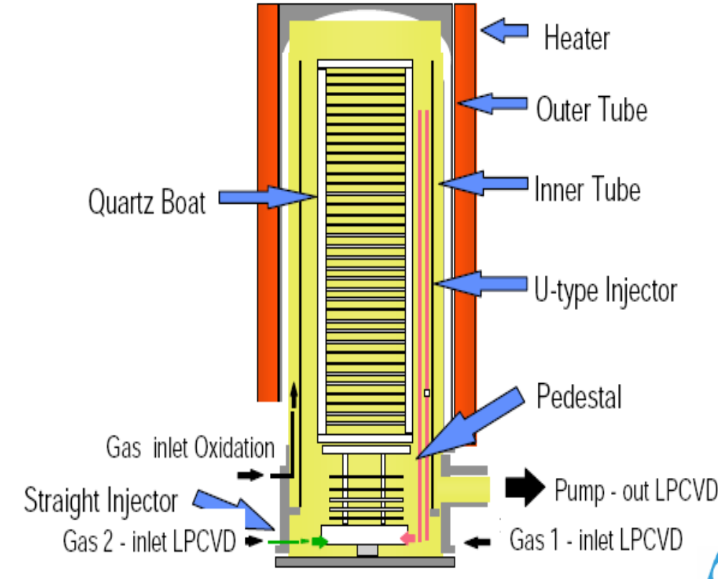
Silicon oxidation equipments/techniques
Vertical furnaces
  Wafers batches (up to 100) are inserted in a quartz tube.
  Reactant gases are flown in the furnace
  Desired T is reached by resistive heating
Furnace

Slide 33



RTO
Rapid thermal oxidation (RTO) is increasingly used in the growth of
thin, high-quality dielectric layers and to reduce the thermal budget.
Kinetics may be influenced by both thermally and photon induced processes
Activation energies are usually different from conventional growth techniques ones

Slide 34


Advanced oxidation techniques
Radical oxidation (e.g. ISSG by Applied Materials):
  H₂ and O₂ are directly inserted in a RTO chamber
  Water and radicals (O, OH) are formed
  Reactive species and low pressures guarantee high quality oxides

Slide 35

Silicon oxidation equipments
Plasma oxidation: e.g. SPA
Low thermal budget (300/500 °C)
Ultra thin, high quality oxides

Slide 36

Alternative gate oxides
Dielectric constant
A practical SiO₂ thickness to avoid gate tunnelling: 0.8 nm
If x_{ox} cannot be scaled→ higher k
Requisites for an alternative gate dielectric:
  High k
  Band offset with respect to Si >1eV, band gap >4/5 eV
  Thermodynamically stable in contact with Silicon
  Compatible with IC process flow

Slide 37

Alternative gate oxides

Slide 38

Silicon oxide colour chart
http://www.ee.byu.edu/cleanroom/color_chart.phtml

